Slide 1
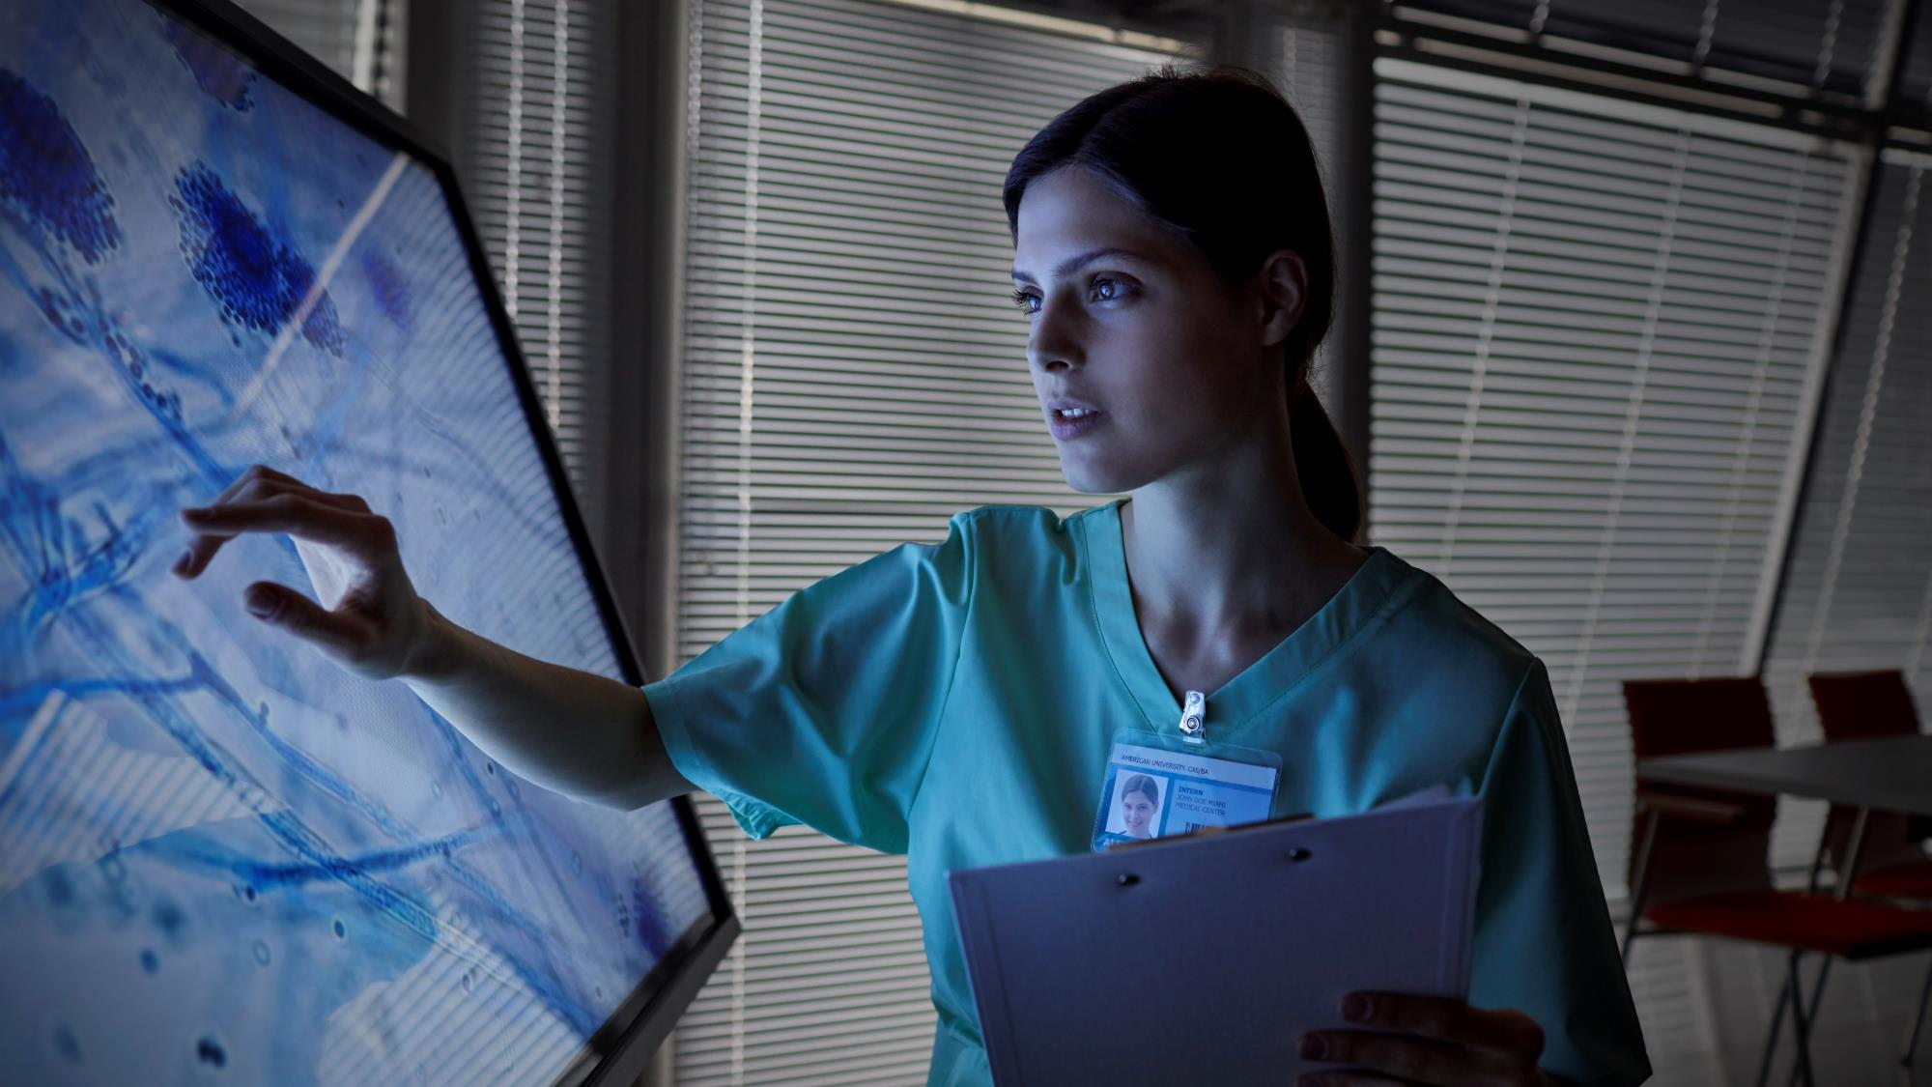
Utilizing Artificial Intelligence for Sustaining Fast and accurate Healthcare System
Course Name: Senior Design
Course Code:CSE499A
Semester: Spring 2021
Supervisor
Dr. Shahnewaz Siddique
Assistant Professor
Electrical & Computer Engineering, North South University

Slide 2


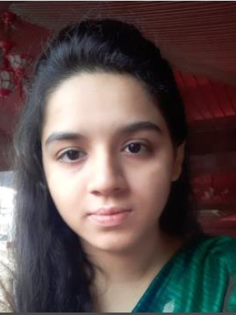
THE TEAM
Md. Shofiul Islam
1712698642
Section 8
Anika Tahsin Meem 1721810642
Section 8
Jaynab Sultana
1721182042
Section 21
Surgeon

Slide 3

Introduction
What is Fast and accurate Healthcare System?
Objectives
Related works
Problem Statement
Background of the problem
Architecture of the Healthcare System
Proposed Model
Proposed Solution
Outcome
Conclusion And future work
Outline of the presentation

Slide 4
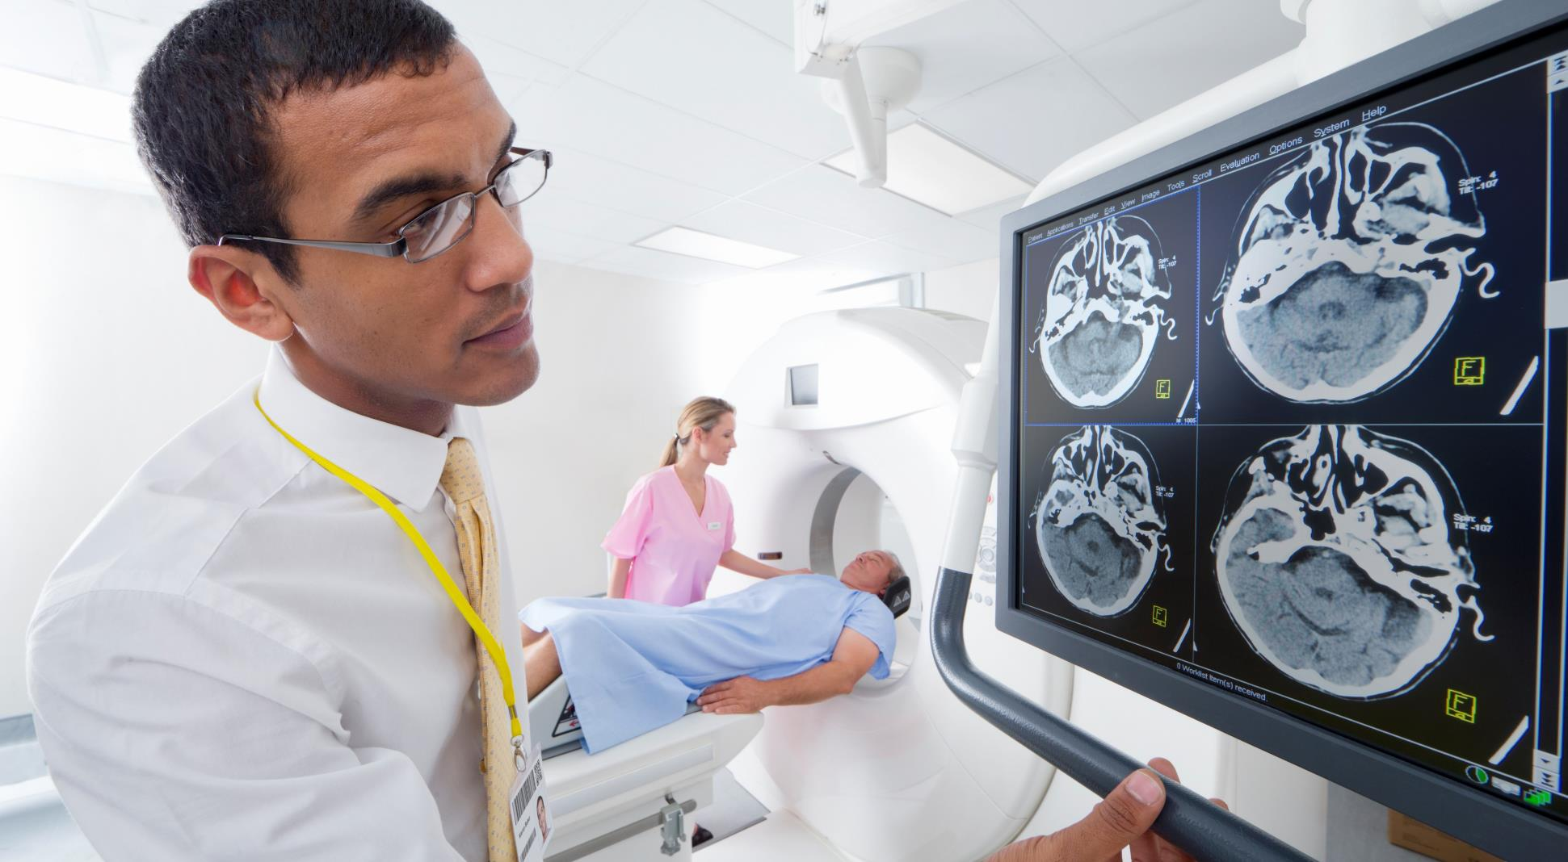
Introduction of fast and accurate health care system
Artificial intelligent is playing an important role in the medical field.
AI can predict and diagnose disease faster than the medical pathologist with higher accuracy.
The system about healthcare are used to connect patients with doctors in a virtual way and give them the flexibility which is really a desire in this Pandemic nowadays.
AI can assist pathologist for reducing error.

Slide 5
What is Fast and accurate Health care System?
A Fast and accurate Healthcare System is a computer program which enables users to predict a simple disease to large disease through image processing and symptoms and prescribed the users through online.
Fast and accurate Healthcare System are typically designed to:
Connect doctor and patient through online
Predict and diagnose disease with high accuracy.
Guide the patient to correct care based on the diagnosis and prediction.

Slide 6
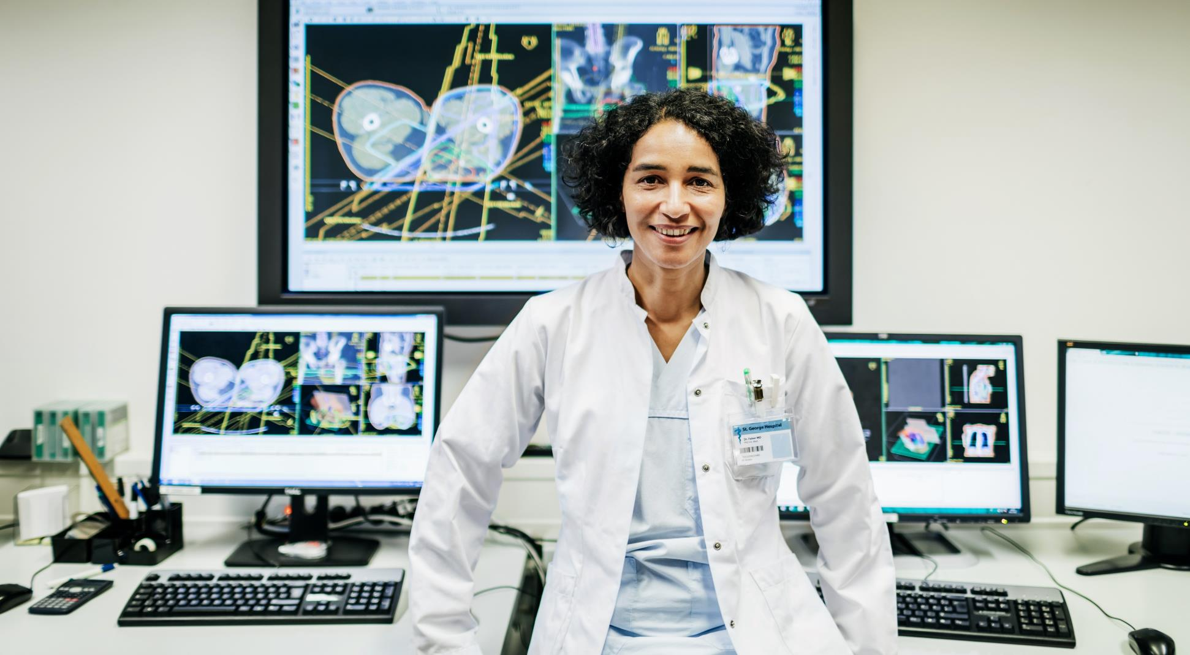
Objectives
To diagnose the complex disease early and take proper treatment.
Doctor can monitor and care his patients.
Patient can take appointment to medical Specialist. To reduce the wastage of time and money.
Consultation Available
To detect cancer in early stage.

Slide 7
Related works
M. M. Kamruzzaman works at Architecture of Smart Architecture Of Smart Health Care System Using Artificial Intelligence.
PATHAI is developing machine learning technology to help more accurate cancer diagnosis with Artificial Intelligence.
Buoy Health is an Artificial Intelligent based Symptom Checker.
BETH ISRAEL DEACONESS MEDICAL CENTER is using Artificial Intelligence to diagnose potentially deadly blood diseases.

Slide 8
Problem Statement
Bringing a large population under healthcare is a big challenge in Bangladesh. Moreover, many people in this huge population die because some diseases are not detected at an early stage.
Unmanageable patient load in hospitals.
Political uncertainty and lack of a disciplined regulatory process.
Many people come from far and wide by transport. As a result, both their time and money are wasted.
An effective efficient platform is needed to reduce the diagnostic errors.

Slide 9
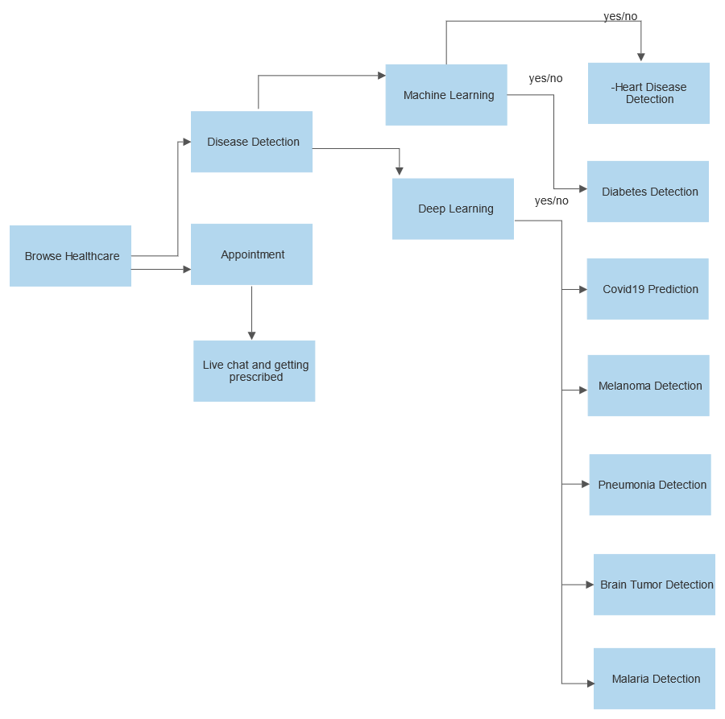
Architecture of the Healthcare System

Slide 10
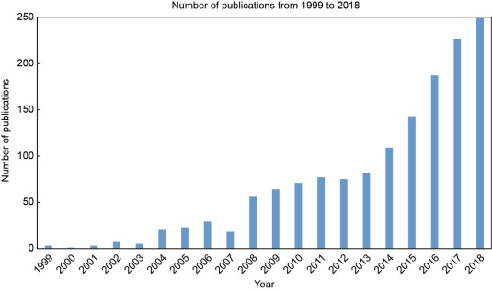
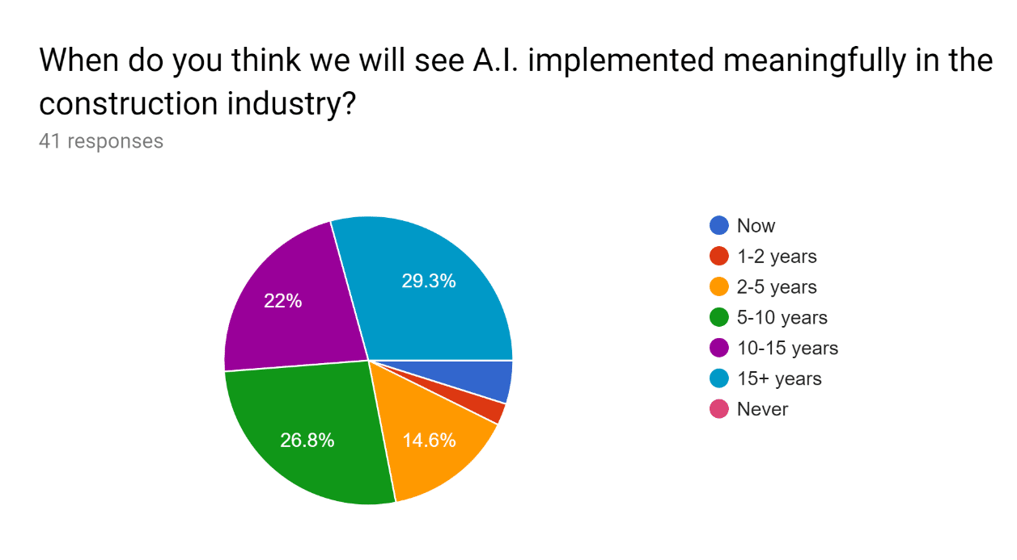
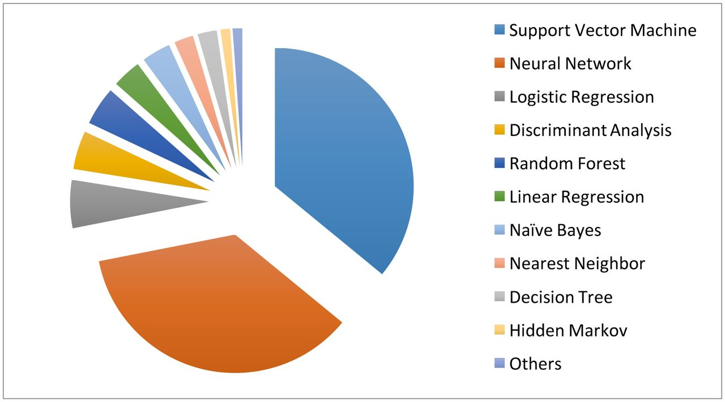
Background

Slide 11
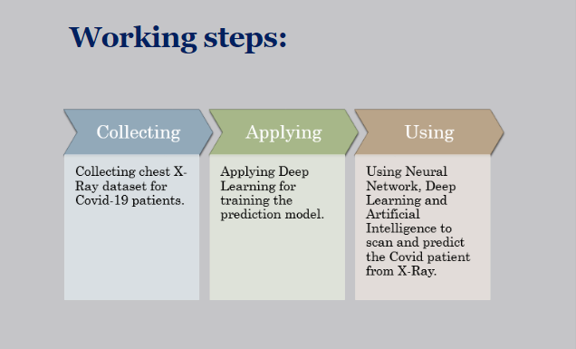
Proposed Model:
For building the model of detect the disease with image or their data, first we downloaded the dataset from Kaggle and other websites.
After that we trained the dataset and build the model, got good accuracy and validation.
We build the model of multiple diseases like Pneumonia, Melanoma, Covid, Diabetes etc.
The working steps are:

Slide 12
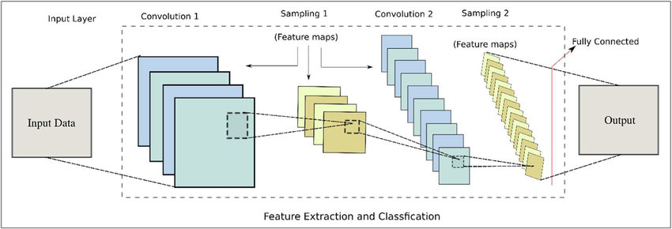
Tools and Algorithms:
Convolutional Neural Network
DENSENET Classification
RESNET Classification
Random Forest Classification
TENSORFLOW
KERAS

Slide 13
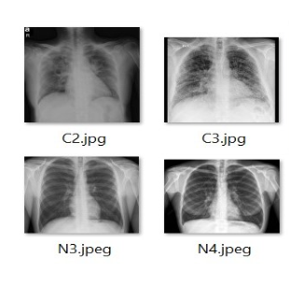
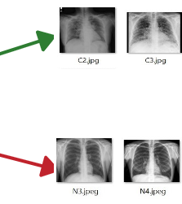
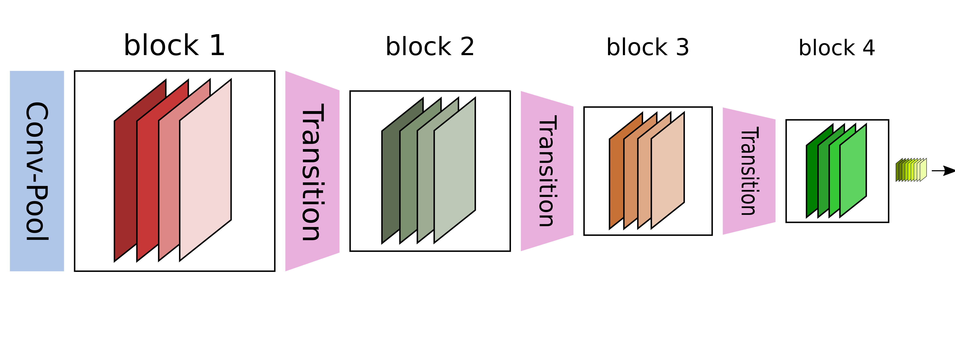
Training the Models (Dense Net Architecture):
DenseNets are separated into Dense Blocks, where the measurements of the highlight maps remains steady inside a piece, but the number of channels changes between them. These layers between them are called Move Layers and pay attention of the down sampling applying a bunch normalization, a 1x1 convolution and a 2x2 pooling layers. Within the new deeper level speaking to the primary Thick Layer inside the primary Thick Square, able to see how really this behavior of including 32 times the number of layers is accomplished. We perform as the creators propose a 1x1 convolution with 128 filters to diminish the highlight maps estimate and the perform a more costly 3x3 convolution (keep in mind to incorporate the cushioning to guarantee the measurements stay steady) with this chosen 32 number of include maps of development rate.[24] Then, the input volume and the result of the two operations (which are the same for each Thick Layer inside each Thick Piece) are concatenated,

Slide 14
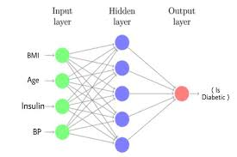
Random Forest Architecture:

Slide 15
Proposed Solution:
Proposed Solution
Till now We have been able to do proposed the particular model which we will use for disease detect in the frontend part.
After doing the backend tool, we will do the frontend tool. We are interested to use languages are HTML, CSS, JAVASCRIPT, Django.
The service tools will be useable because it is inexpensive for user. However, without expert guidance anyone can use the system.

Slide 16
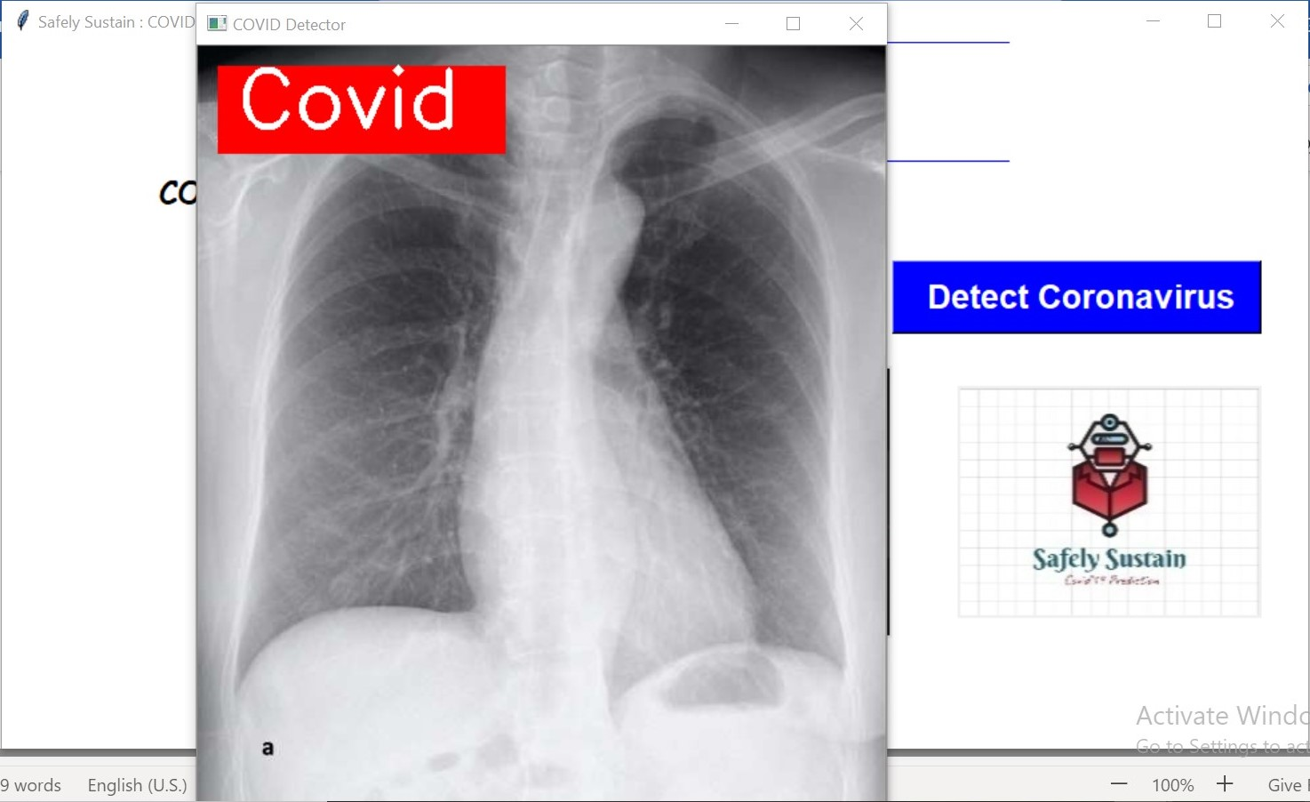
OUTCOME OF THE Fast and accurate Healthcare System
Figure 1: Prediction of COVID19

Slide 17
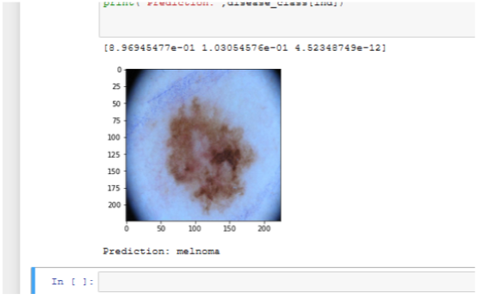
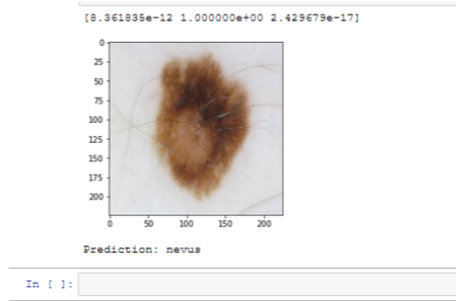
OUTCOME OF THE Fast and accurate Healthcare System
Figure 2: Prediction of Melanoma and non-melanoma

Slide 18
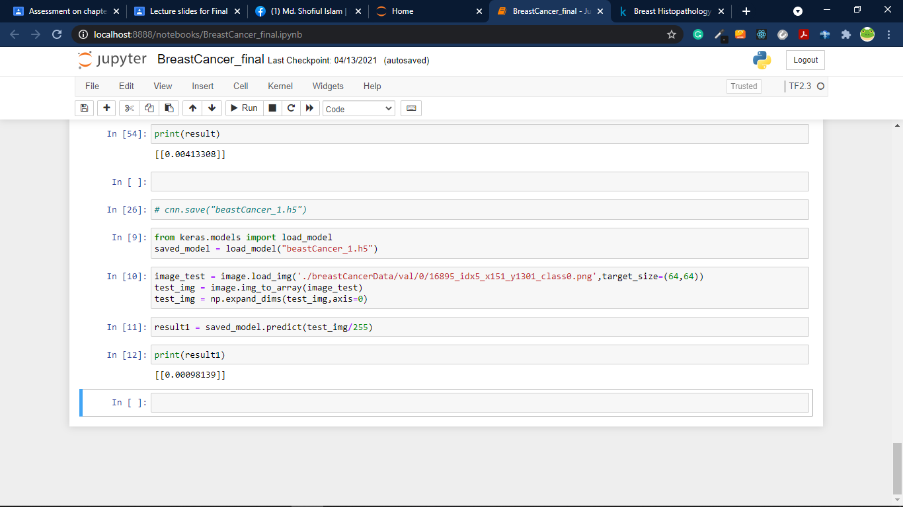
OUTCOME OF THE Fast and accurate Healthcare System
Figure 3: Prediction of Breast Cancer Detection

Slide 19
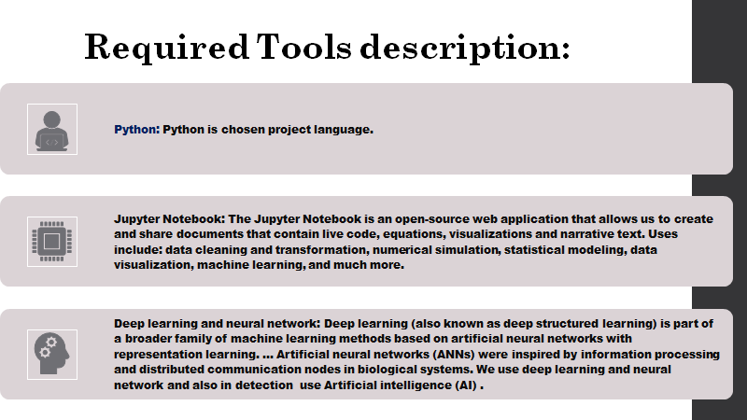

Slide 20
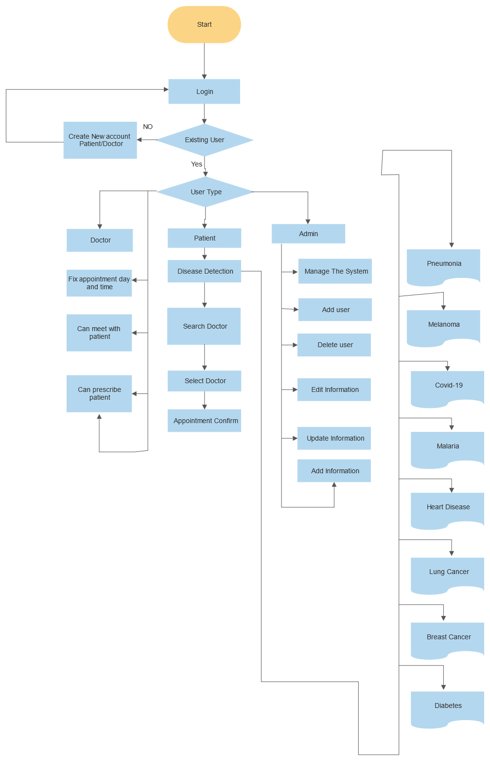
Flowchart of the healthcare system

Slide 21
Conclusion And future work
The reason for building such system is to assist doctor and patient.
It will become a more efficient system and reliable system to the user.
Artificial neural network will increase the accuracy of the system.
Our system will be available in website platform.

Slide 22

Thank you

